Slide 1
Lead User Guide:
Application for Individual Accreditation
Updated 05/11/2018
Notes:
Welcome to the online tutorial for the Lead program’s Application for Individual Accreditation. This tutorial will walk you through the process of completing and submitting an application to EPA for individual certification under the Abatement program.

Slide 2
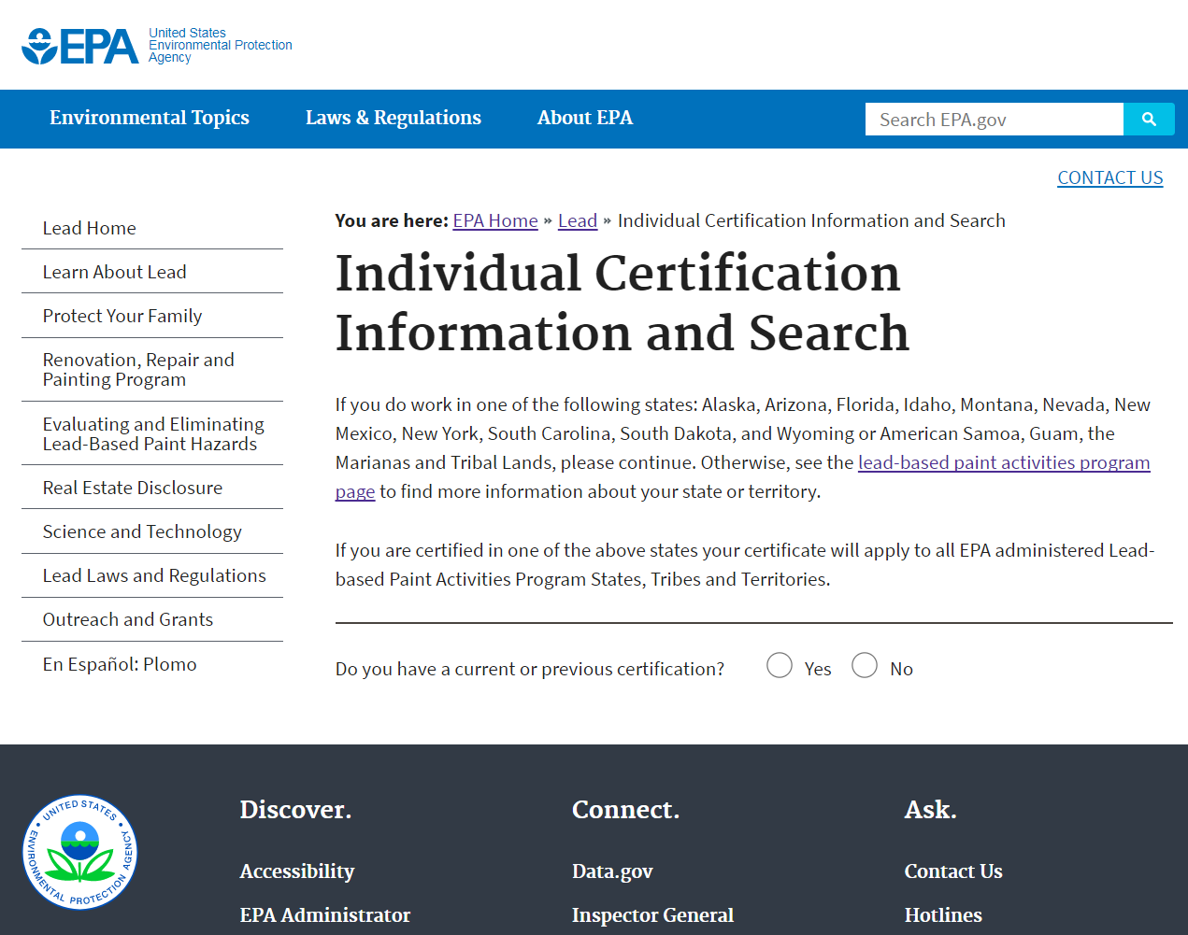
https://cfpub.epa.gov/flpp/pub/index.cfm?do=main.individualSearch
Individual Certification Public Site
Notes:
The Individual Certification application can be accessed through EPA’s Lead-Safe Certification Program public website, located at https://cfpub.epa.gov/flpp/pub/index.cfm?do=main.individualSearch.
If you have a current or expired certification for which you are seeking recertification or to make an update, select “Yes” to search for your certification. If you do not have a previous certification, select “No” and click the “Enter New Application” button.

Slide 3
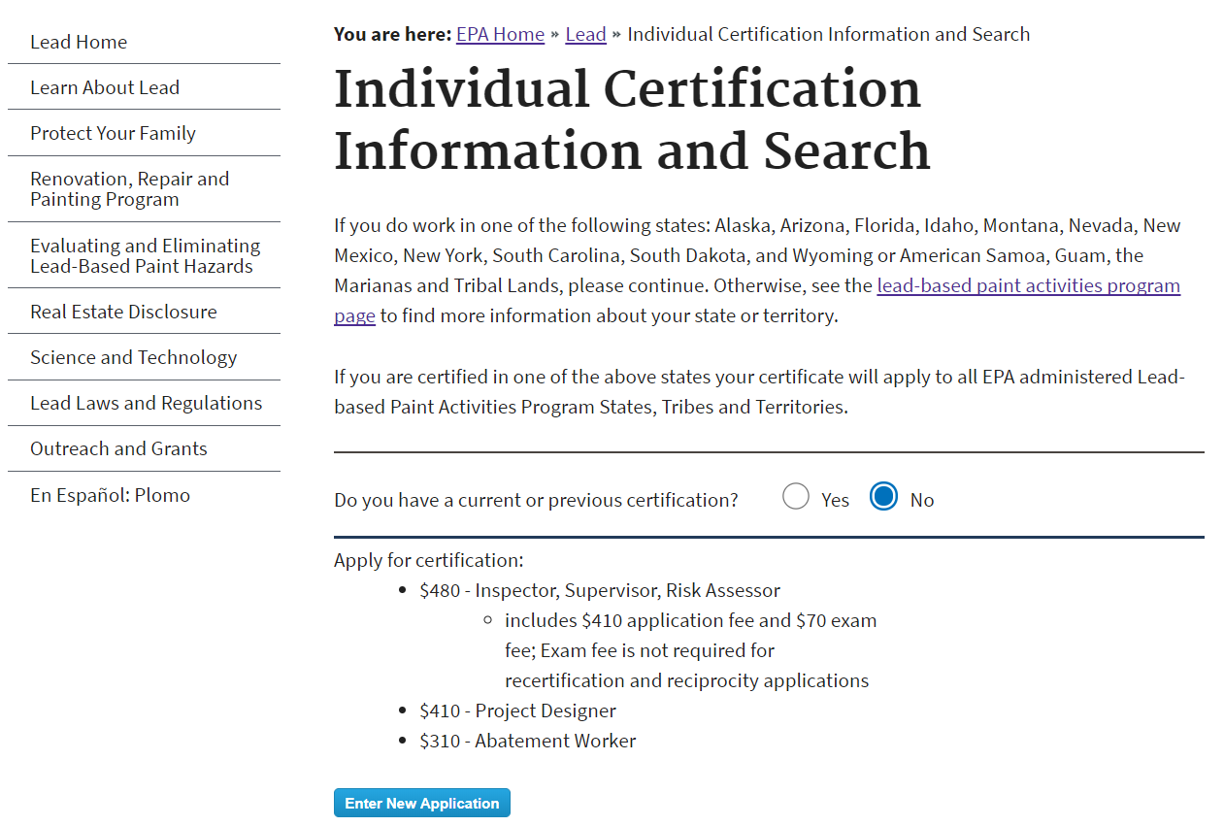
Individual Certification Public Site
Notes:
Selecting “No” will make the above text appear. Make sure to review this text carefully and take note of the fees associated with the discipline of your choice.

Slide 4
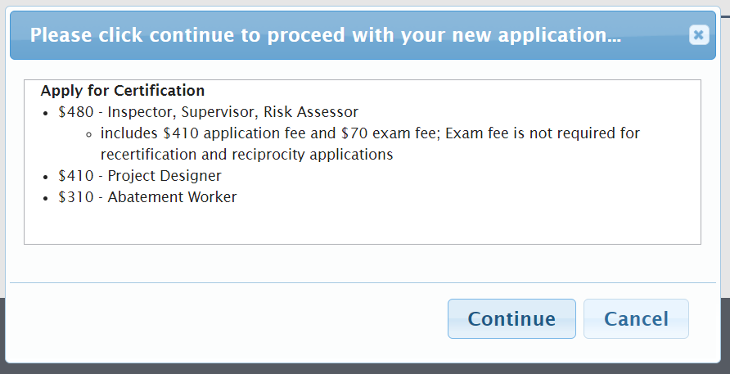
Individual Certification Public Site
Notes:
Selecting “Enter New Application” will display the same text in a pop-up window. Click “Continue” to be directed to the CDX Log In/Register page.

Slide 5
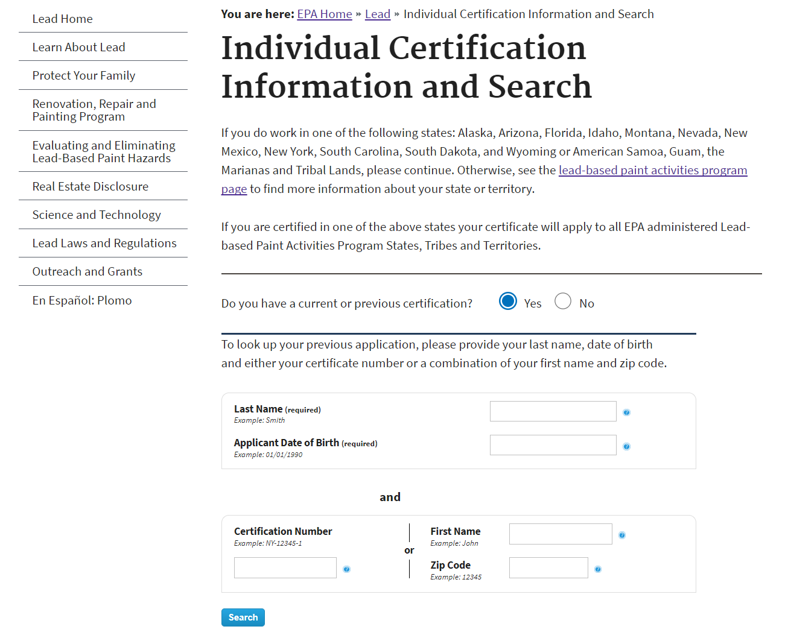
Individual Certification Public Site
Notes:
Selecting “Yes” to indicate you have a current or previous certification will allow you to search for your certification by entering your last name, date of birth, and certification number or first name and zip code. This will take you to the Search Results Page.

Slide 6
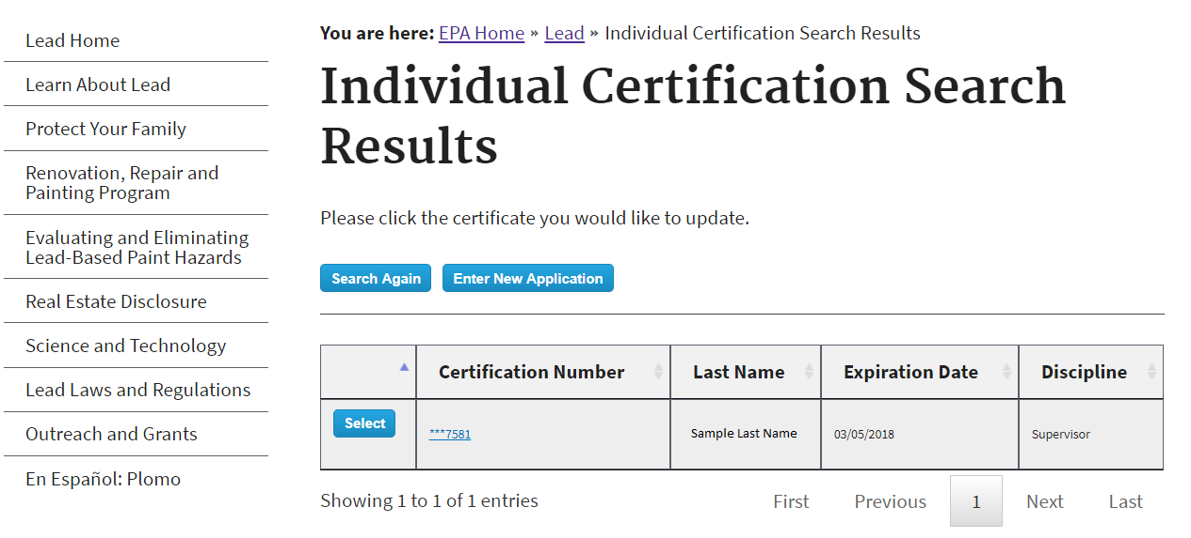
Individual Certification Public Site
Notes:
On the Search Results Page, you can select the certification you wish to recertify or update by clicking the select button or the certification number. If you cannot find your certification you may search again by selecting the “Search Again” button or you may start a new application by selecting the “Enter New Application” button.

Slide 7
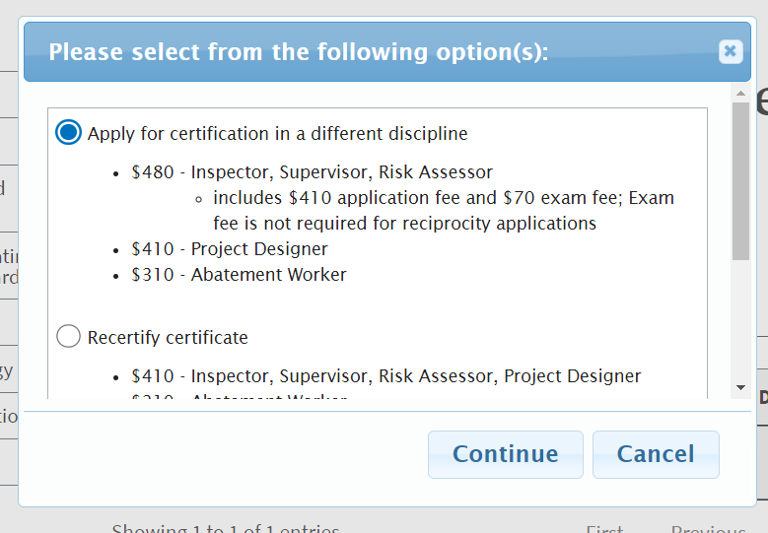
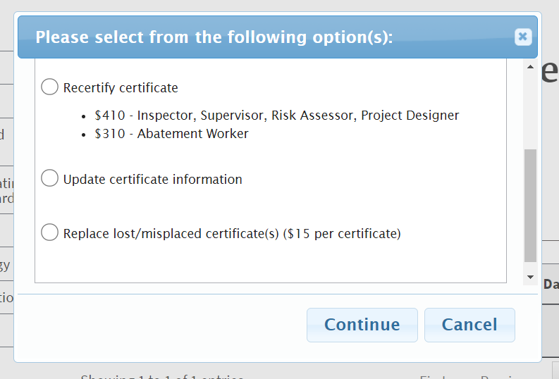
Individual Certification Public Site
Notes:
When selecting your previous certification, a pop-up will display with the options to apply for certification in a different discipline, recertify, update certificate information, and replace certificate(s). Getting a certification in another discipline will not recertify your previous certification, but will allow you to be certified to perform work in another discipline. An abatement worker certification costs $310 while Inspector, Supervisor, Risk Assessor, and Project Designer certifications cost $410 each. Recertification will allow you to be recertified in a discipline for which you already hold a certificate. “Update certificate information” will open an information amendment application, in which you can update the information on your previous application, including contact information. “Replace lost/misplaced certificate(s)” will open an application to receive a replacement copy of your certificate. Each replacement certificate is $15 per discipline. Select which option is appropriate for your needs, and then click the “Continue” button.

Slide 8
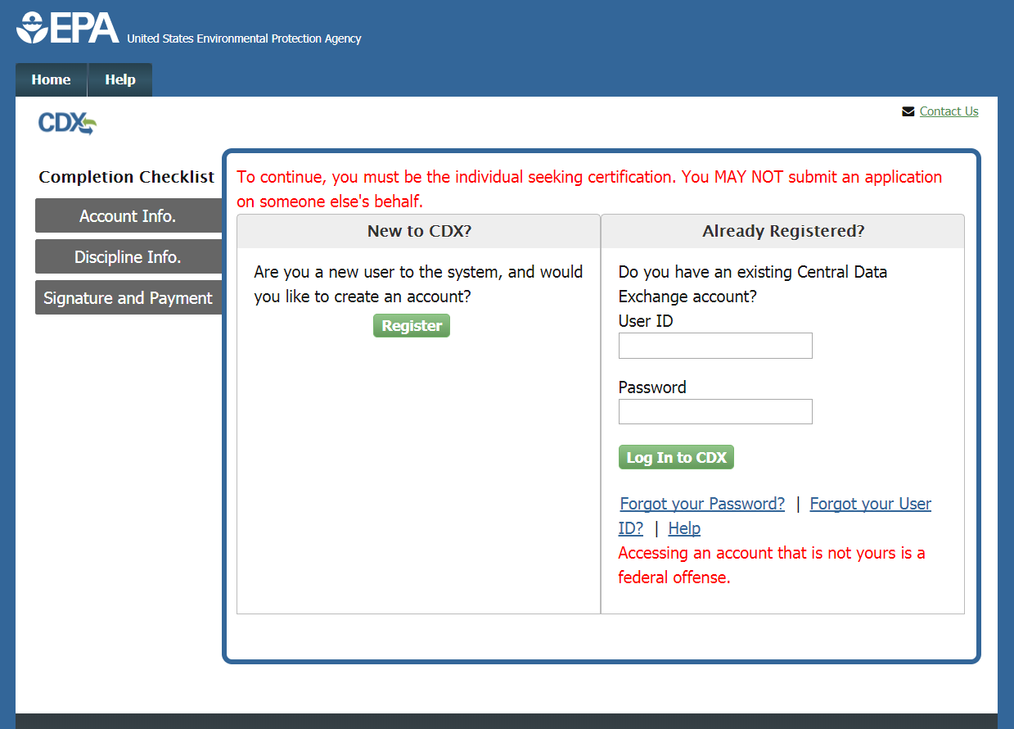
CDX Login/Register
Notes:
Once you select an application, you will be directed to the CDX Log In/Register page. If you have previously used the Central Data Exchange for reporting, type your CDX user ID and password and click the “Log In to CDX” button. If you have a CDX account but have forgotten your User ID or password, click the appropriate links and follow the steps provided to recover that information. If you are new to CDX, click the “Register” button to create a new account.
Please note, you must be the individual seeking certification to submit an application. You may not submit an application on someone’s behalf.

Slide 9
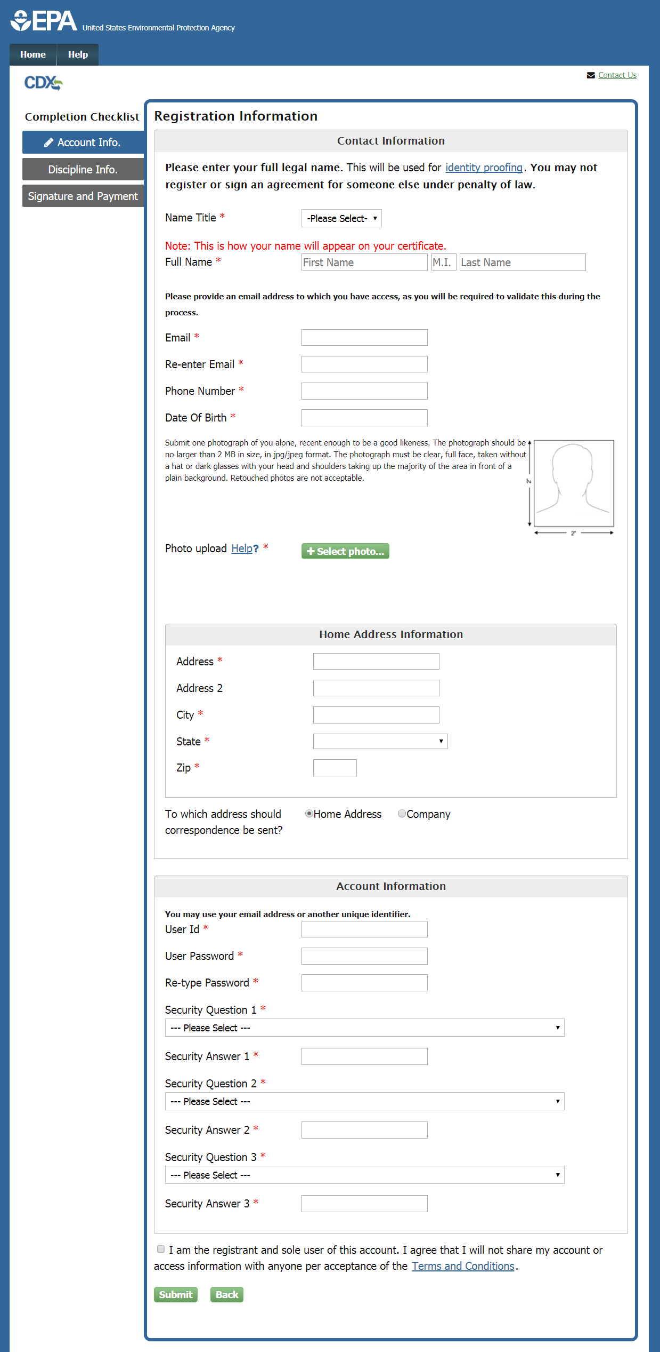
Individual Application
Notes:
New CDX users must fill out the Account Information page to create their CDX account as the first part of the application process. Enter the appropriate information in the fields in this section; please use your full legal name in the Full Name fields as this will be used for electronic identity proofing later in the process. For more information on the identity proofing process, click the ‘Identity proofing’ link. Upload a JPEG or JPG passport sized photo of yourself by clicking the “Select photo” button. This is needed to complete your application. Create a User ID and Password for CDX by entering a unique identifier in the User ID field; this may be your email address or another screen name. Do not use your social security number as your user ID. Be sure to remember the password you choose; you will need to enter it later in order to sign your application. Select three security questions and enter answers for each that you will remember but are hard to guess. Before continuing, click the link to open and carefully read the Terms and Conditions of the CDX system. Select the check box to agree to the Terms and Conditions before continuing by clicking the “Submit” button.

Slide 10
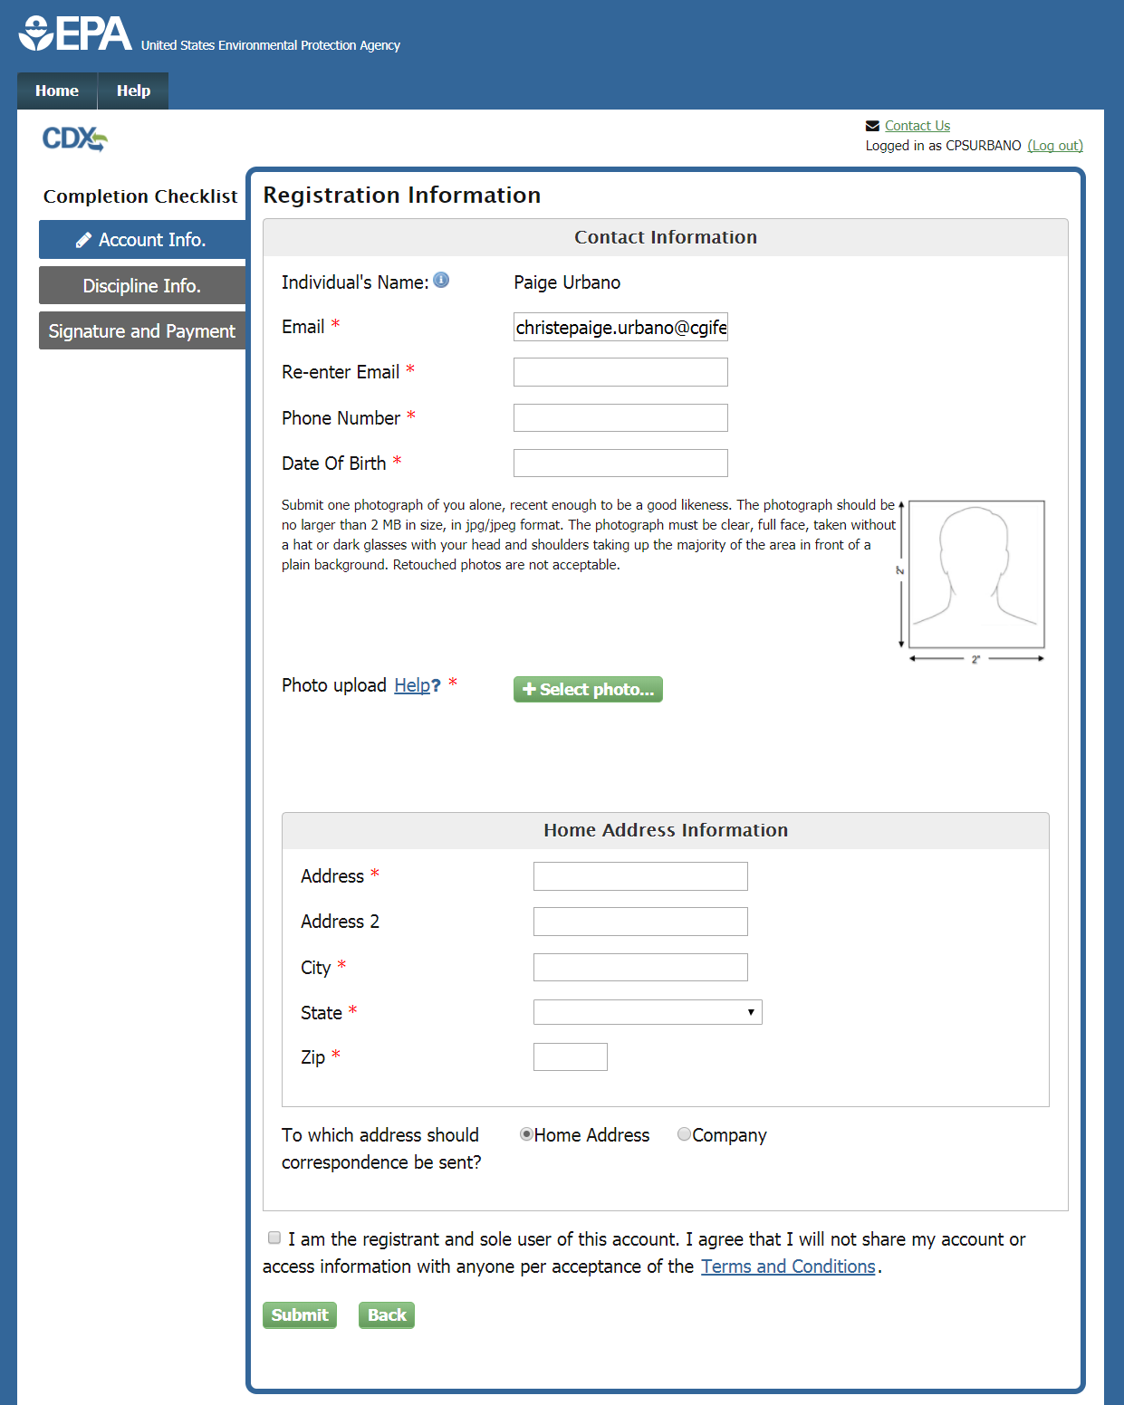
Individual Application
Notes:
Existing users will also need to complete the Account Information Page. You will need to complete the Contact Information section as well, however your Full Name is not required because that information is stored with your CDX account. Upload a JPEG or JPG passport sized photo of yourself by clicking the “Select photo” button. This is needed to complete your application. Fill in the Home Address Information section and choose where you would prefer correspondence to be sent. Before continuing, click the link to open and carefully read the Terms and Conditions of the CDX system. Select the check box to agree to the Terms and Conditions before continuing by clicking the “Submit” button.

Slide 11
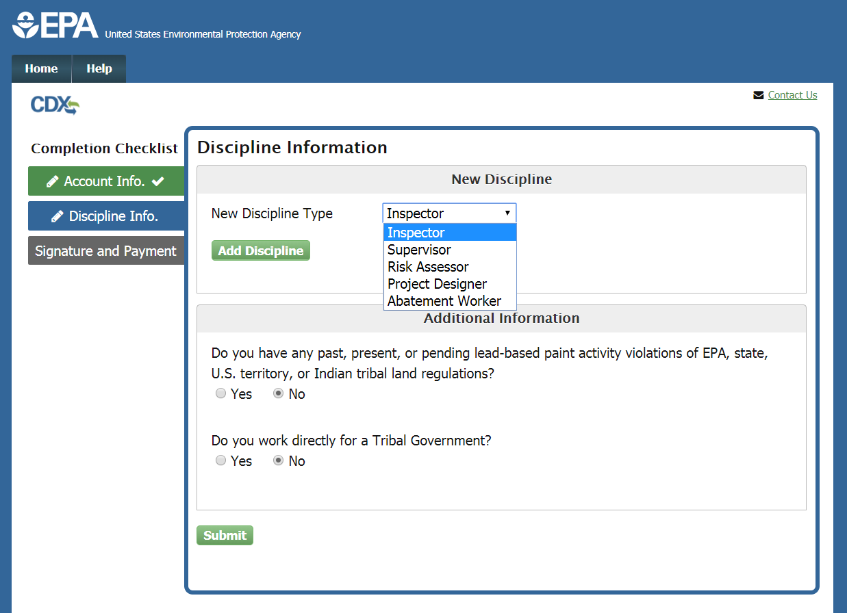
Individual Application
Notes:
On the Discipline Information Page select the discipline for which you are seeking certification and click the “Add Discipline” button.

Slide 12
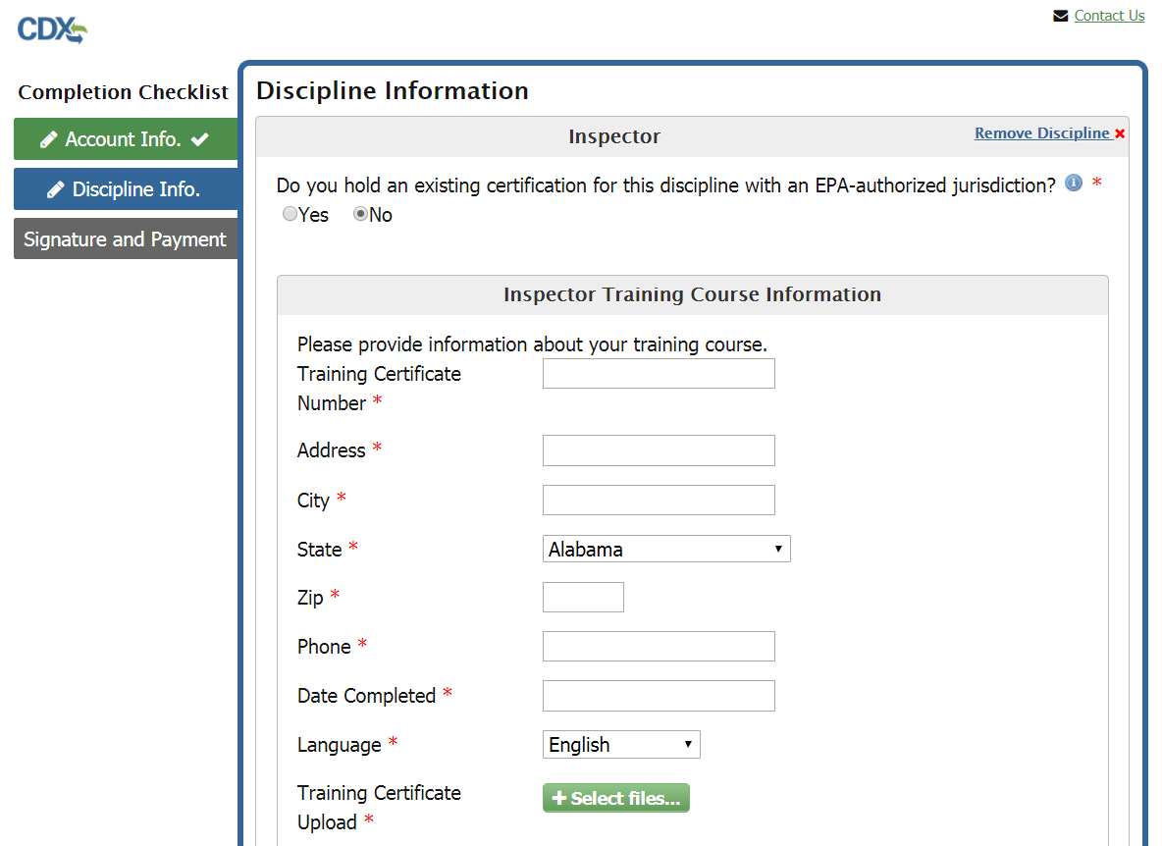
Individual Application
Notes:
If you are being certified through a Training Course, select “No” to the question “Do you hold an existing certificate for this discipline with an EPA-authorized jurisdiction?” Fill out the required Training Course Information, as well as the Education and Experience Items if necessary. Upload all necessary files.

Slide 13
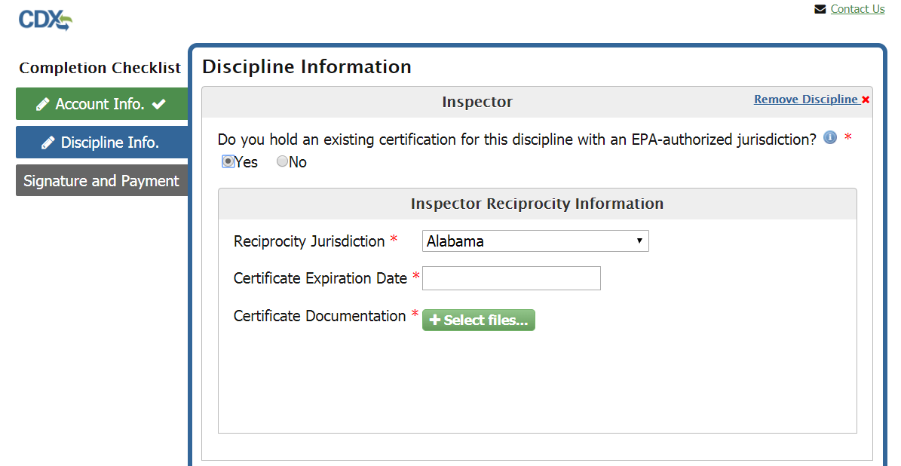
Individual Application
Notes:
If you are being certified through reciprocity, select ‘Yes’ to the question “Do you hold an existing certificate for this discipline with an EPA-authorized jurisdiction?” Fill out the Reciprocity Information section with your certification information and upload all necessary files.

Slide 14
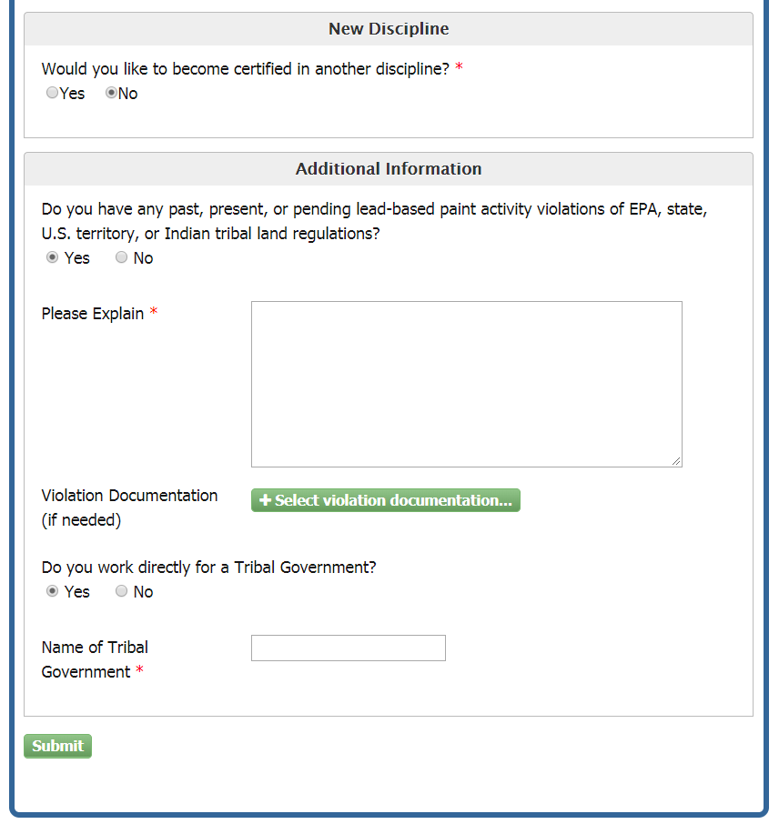
Individual Application
Notes:
If you wish to add another discipline you may do so by selecting “Yes” to the “Would you like to become certified in another discipline?” question. You can then add a new discipline by selecting it from the drop-down and clicking the “Add Discipline” button. If you have any violations, select “Yes” to the “Do you have any past, present, or pending lead-based paint activity violations of EPA, state, U.S. territory, or Indian tribal land regulations?” question. You can then type your explanation in the “Please Explain” text box and, if necessary, upload a violation document by clicking “Select violation documentation” button. If you work for a tribal government you can select “Yes” to the “Do you work directly for a Tribal Government?” question and type the name of the tribal government in the “Name of Tribal Government” field. Click the “Submit” button to continue.

Slide 15
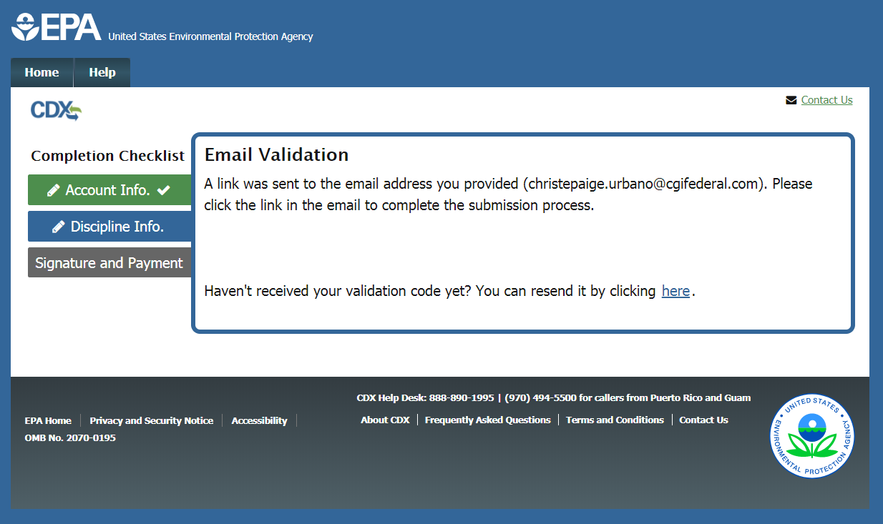
Email Validation
Notes:
Once you complete the Discipline Information page, an email will be sent to the email address you’ve provided. Please check for the email, and click the link to validate your email.

Slide 16
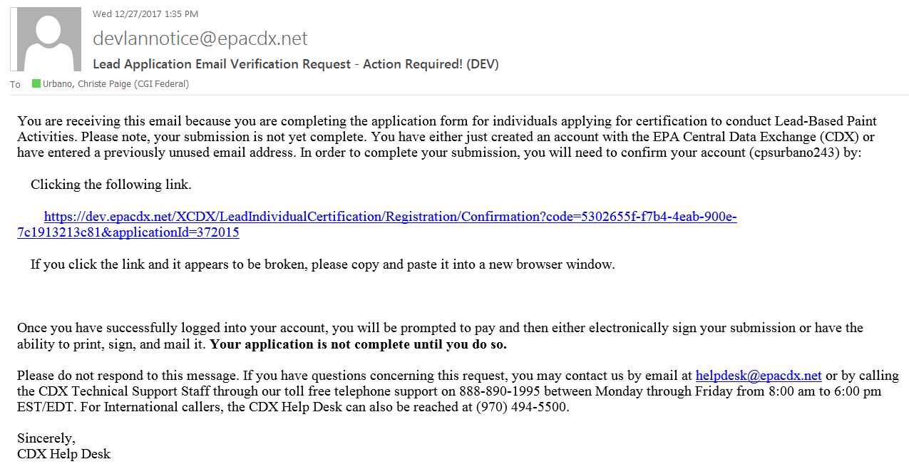
Validation Email
Notes:
This is an example of the email you will receive. Click the link provided to validate your email and continue to the Review and Payment Page.

Slide 17
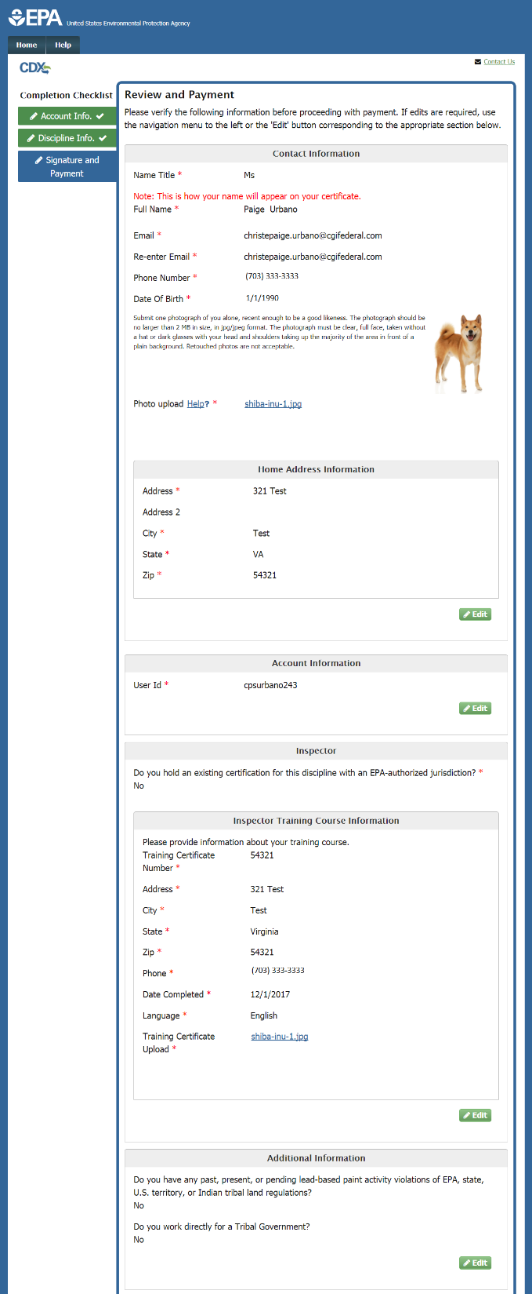
Review and Payment
Notes:
On the Review and Payment page, verify that the information displayed in read-only format is correct and complete. If any changes are required, click the “Edit” button next to the appropriate section on the page.

Slide 18
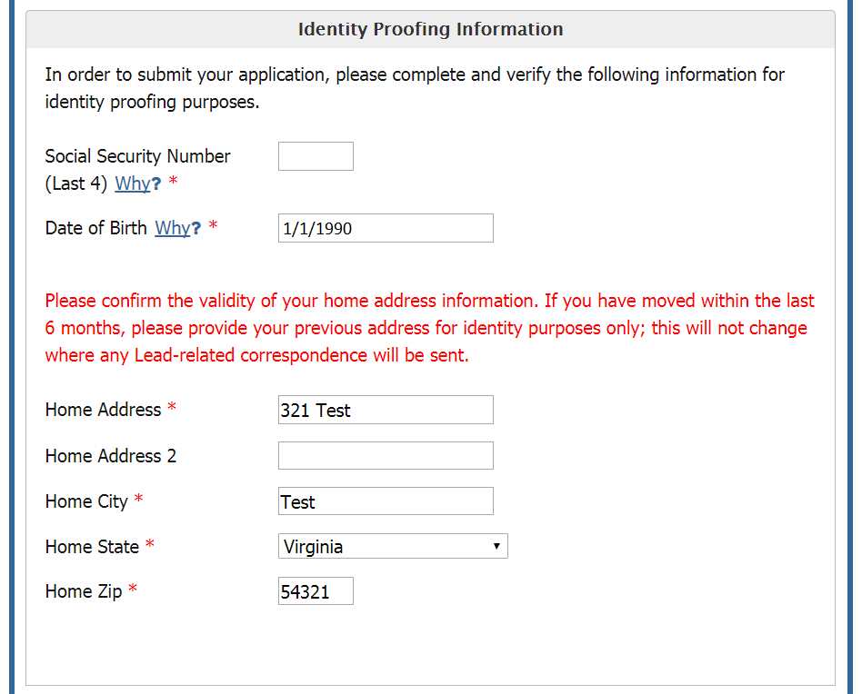
Identity Proofing Information
Notes:
Complete the Identity Proofing Information section on the Review and Payment page. Enter the last four digits of your SSN and your date of birth, and confirm the validity of your home address.

Slide 19
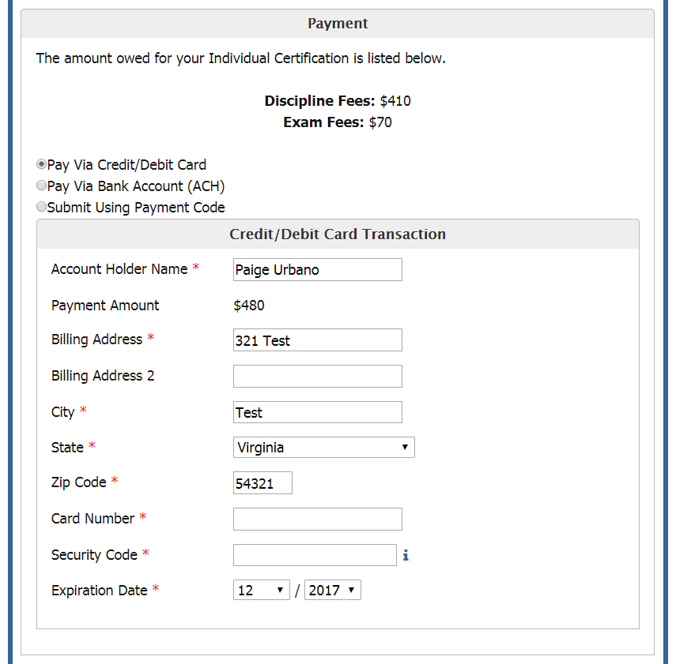
Payment – Credit Card
Notes:
The total cost of your certification is displayed in the Payment section. You may select to pay this amount either by credit or debit card, with a bank account ACH transfer, or with a payment code. Select the appropriate method by clicking the radio button next to your selection. To pay by credit or debit card, enter the card number, security code, and expiration date of the card. If the name or address of the cardholder is different from what is displayed, edit those fields.

Slide 20
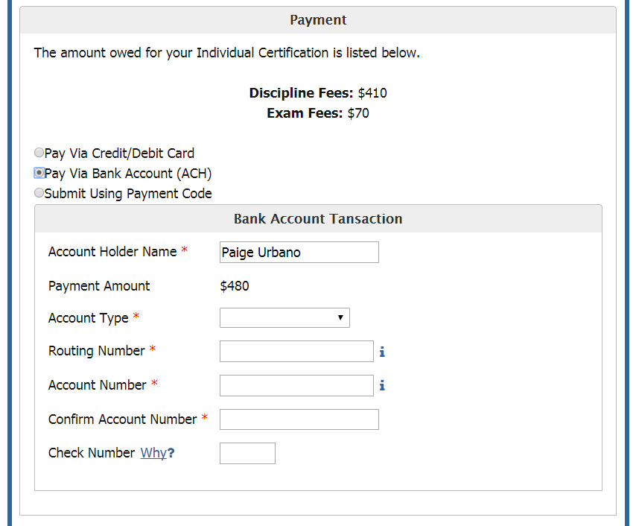
Payment – Bank Account
Notes:
To pay with a bank account transfer, select the account type and enter the routing number and account number. When you have completed this information, click the “Complete payment” button to submit and pay for your application.

Slide 21
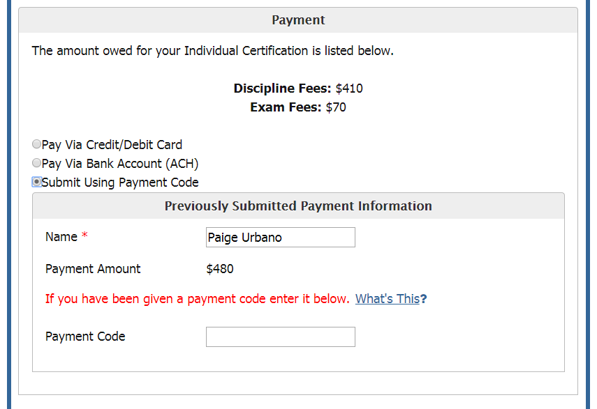
Payment – Payment Code
Notes:
To pay with a payment code, select the appropriate radio button. Enter the payment code in the appropriate field.

Slide 22
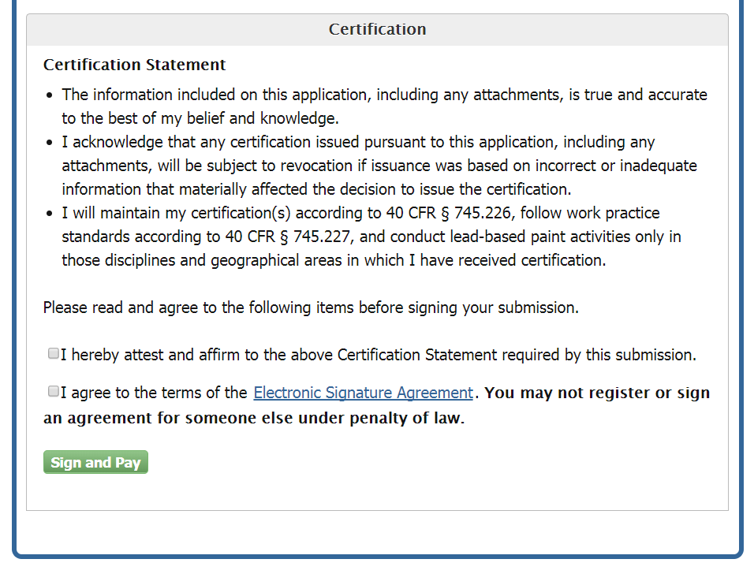
Certification
Notes:
The last section on the Review and Payment page is the Certification section. Read the full text of the Certification Statement as displayed, and affirm your acceptance of the terms. Clicking the link to the Electronic Signature Agreement will display the full text of the document. To sign, you must check both of the boxes to affirm both statements and click the “Sign and Pay” button.

Slide 23
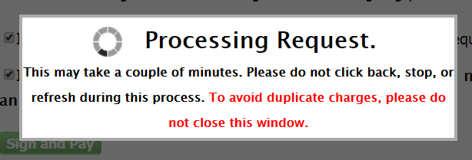
Processing Request
Notes:
The process for submitting the application and processing payment may take a minute or two. It is important that you do not close the window while the system is processing, or you may incur multiple payment charges.

Slide 24
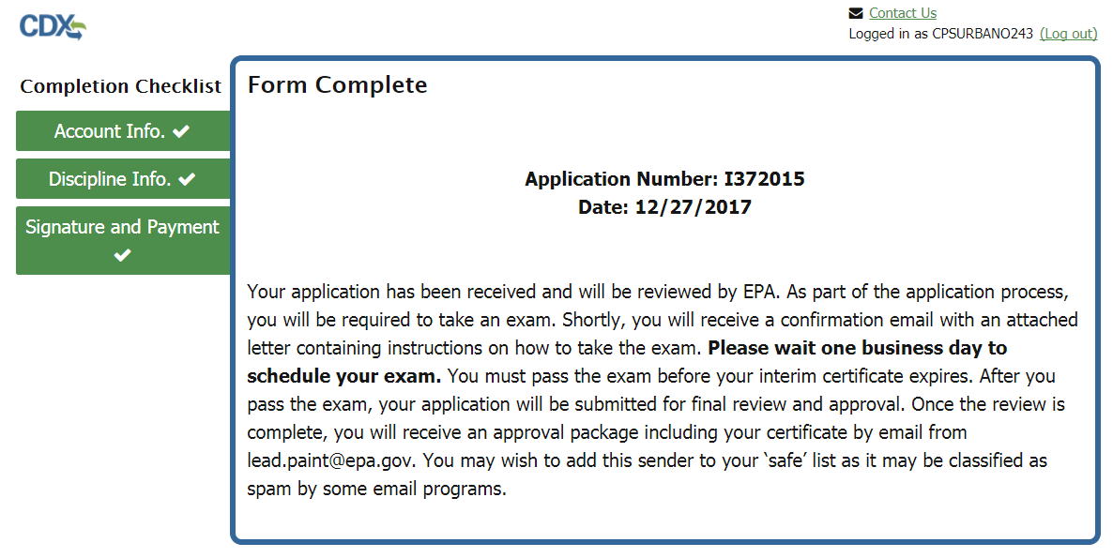
Application Submission Confirmation
Notes:
Once your application is complete and has been signed, you have completed the process. If you pass the electronic Identity Proofing process, your password is considered your legal signature and your application is complete. On this page, you will see your application number and the date that your application was signed. Your application will now be reviewed by EPA. Once the review is complete, you will receive a confirmation email from EPA with details.
Please note: Individual applications are not available on the E-Enterprise Portal (E-Portal). At this point, only Firm applications are tracked through the E-Portal. The applicant will be contacted if there are any issues with their application.

Slide 25
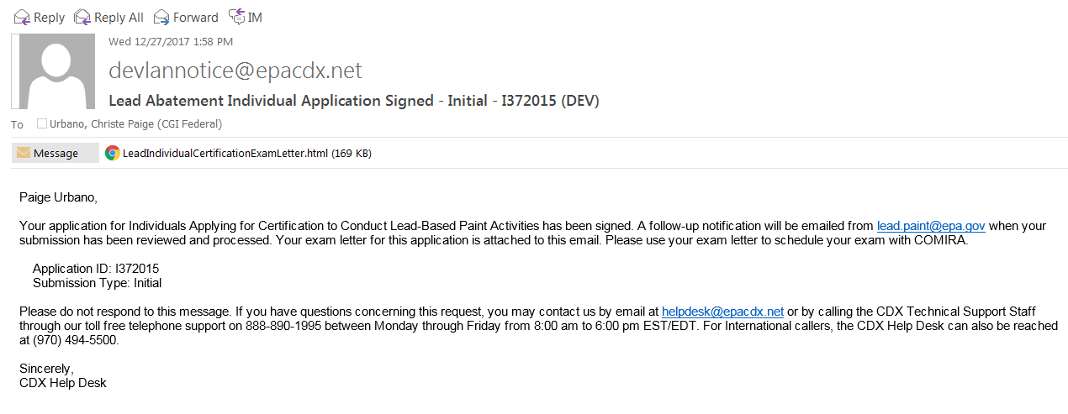
Application Submission Confirmation Email
Notes:
If your application is complete and signed, you will receive an email such as the above to confirm. It will also include a letter detailing the exam you have to take, if you have chosen a discipline requiring an exam. If you paid with a credit/debit card or an ACH transfer, this email will also contain a copy of your receipt.

Slide 26
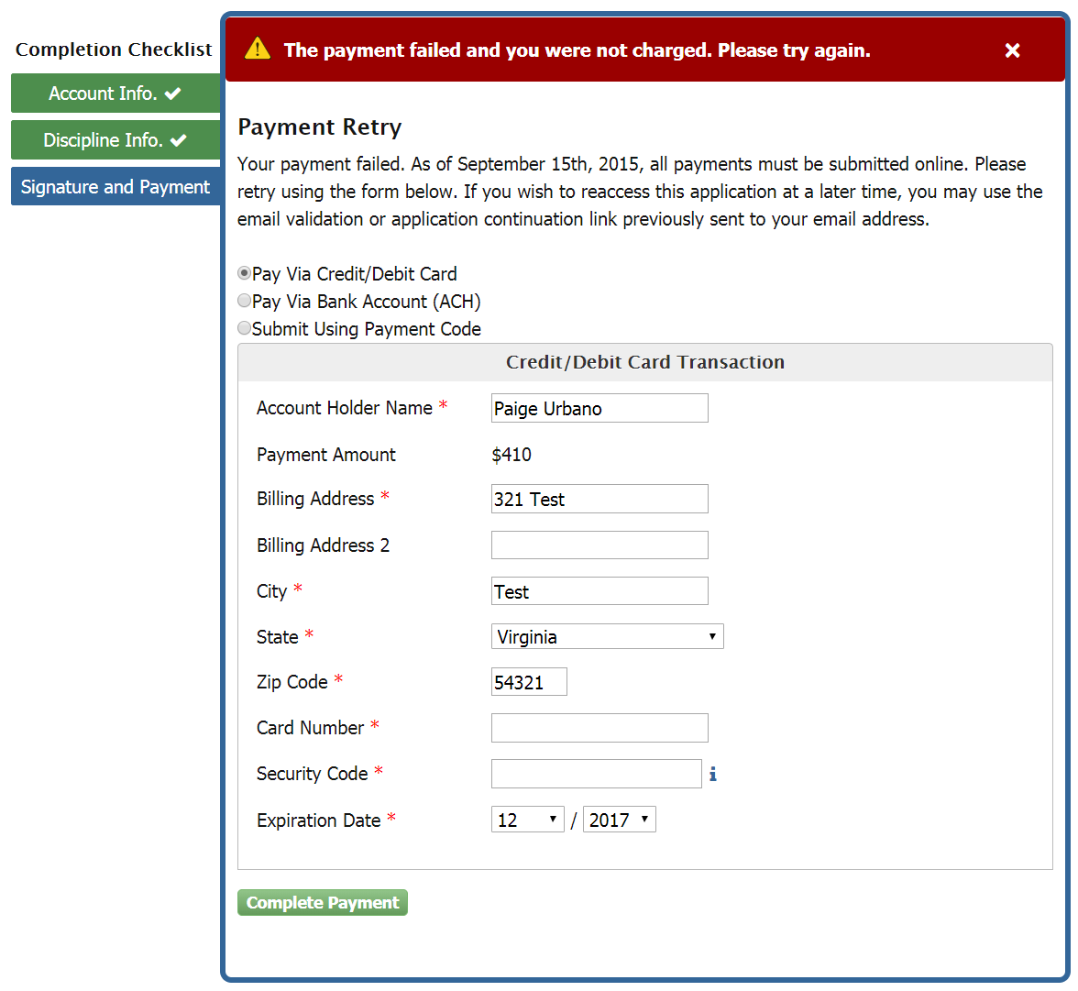
Payment Failed
Notes:
If you fail to complete payment, you will be taken to the payment retry page. As of September 15th, 2015 all users must make payments electronically, so you will continue to be taken to the Payment Retry page until payment is correctly made. You must use one of the three options to submit your payment; credit card/debit card, through a bank account (ACH), or with a payment code.

Slide 27
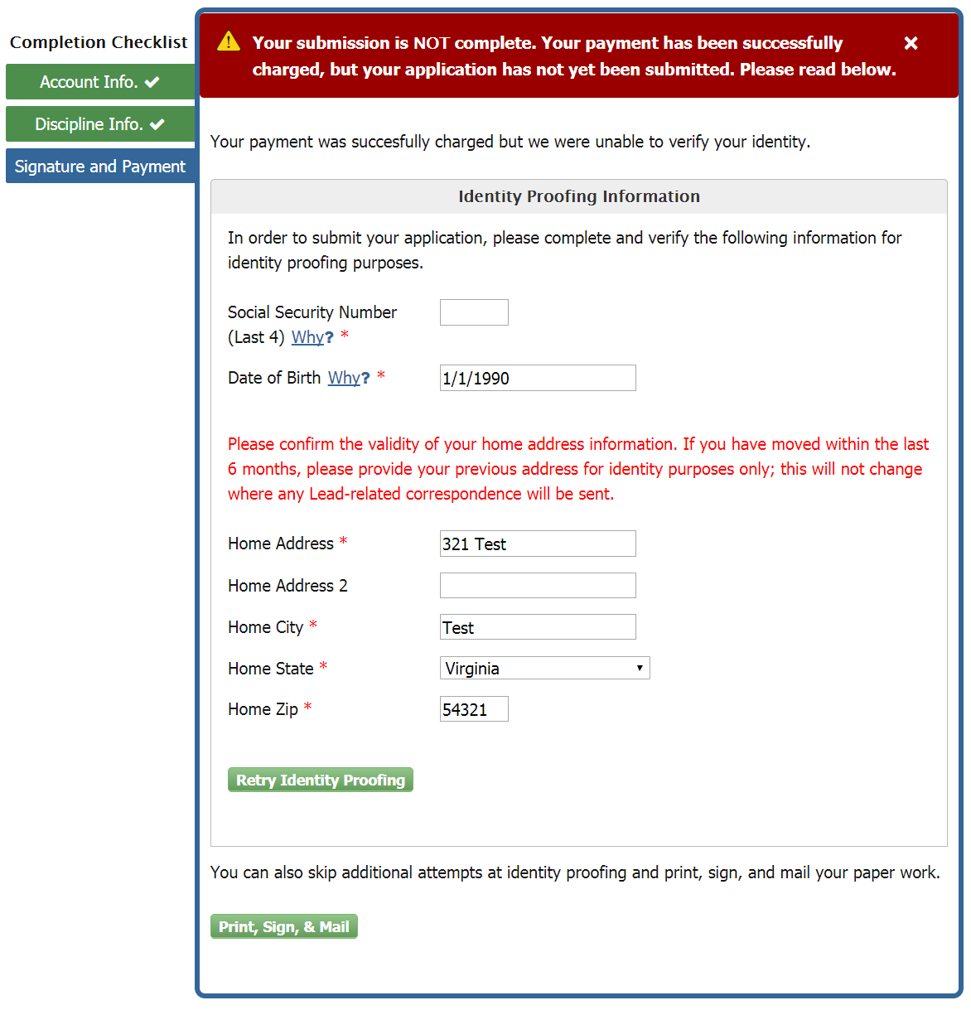
Identity Proofing Failed
Notes:
If you failed identity proofing in the Review and Payment page, you will be lead to the retry page. You will be prompted to enter the last four digits of your SSN and your date of birth, and to confirm the validity of your home address in order to retry identity proofing. You may also click “Print, Sign, & Mail” if you would prefer to mail in your electronic signature agreement.

Slide 28
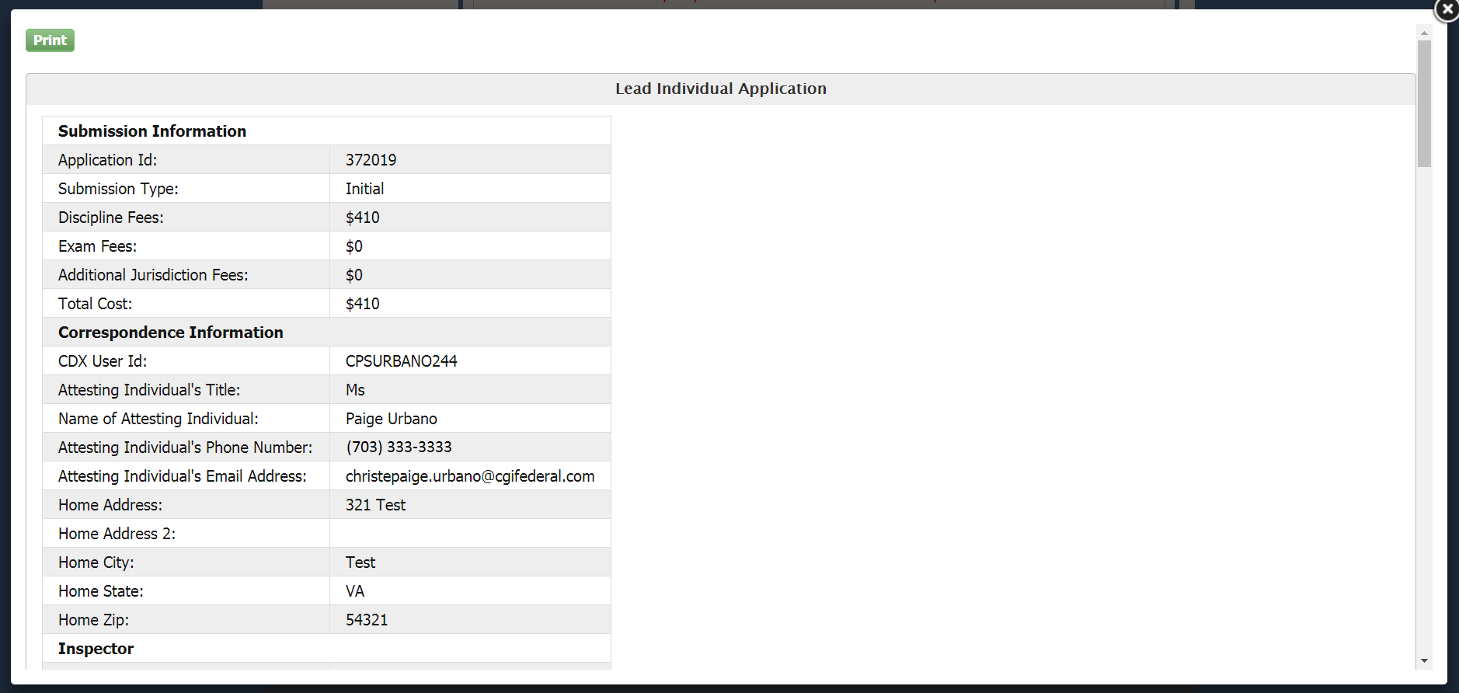
Print - Electronic Signature Agreement
Notes:
This is an example of the electronic signature agreement. This is a necessary part of the application. If you cannot pass identity proofing electronically, you must print, sign, and mail this document to the proper address. The address is listed at the bottom of the document.

Slide 29
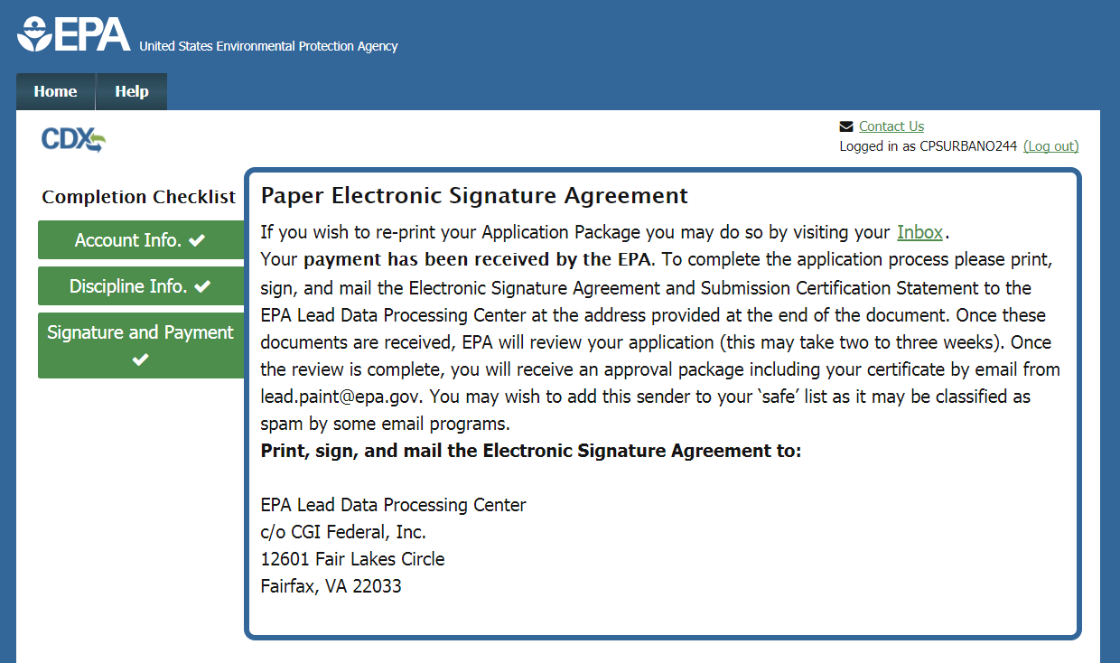
Print - Electronic Signature Agreement
Notes:
A copy of your electronic signature agreement is also available in your CDX inbox. The electronic signature agreement is a necessary part of the application review process.

Slide 30
Helpful Hints
Remember CDX password to sign application
Do not close browser window until you see the confirmation screen
Add lead.paint@epa.gov to your email’s safe senders list
Notes:
To recap, here are a few helpful hints for successfully completing your application. First, be sure to keep track of your CDX password when you log in to the system, or when you create a new account. Second, do not close your browser window until you see the confirmation screen indicating that your application has been successfully submitted. It may take a few minutes to process, but do not close the window until the system indicates that it is safe to do so. Third, certain email systems may label communications from the Lead program as spam. To avoid this, please add lead.paint@epa.gov to your email’s list of safe senders. This concludes the Lead Application for Individual Accreditation tutorial.

